Slide 1
Analysis of Algorithms Week 3

Slide 2
Topics
Definition
Algorithm
Time complexity
Space complexity
Common time complexities
O(1) - Constant time
O(log n) - Logarithmic time
O(n) - Linear time
O(n log n) - Linearithmic time
O(n^2) - Quadratic time
Case Studies
Computing time complexity
Max subsequence sum

Slide 3
Introduction
An algorithm is a clearly specified set of simple instructions to be followed to solve a problem.
An algorithm that takes days to solve a problem is useless
An algorithm that takes gigabytes of space to solve a problem is also useless

Slide 4
What to analyze?
Time it takes to complete the processing
Space it takes to complete the processing
What contributes to the time it takes?
Computer processing power
Computer memory
Data set size
Differ from computer to computer

Slide 5
Importance of analysis
Efficiency and Performance Optimization
Algorithm Selection
Scalability
Resource Management
Benchmarking and Comparison

Slide 6
Big O notation
Big O notation is a mathematical notation used to describe the upper bound or worst-case behavior of an algorithm in terms of its time or space complexity.
It provides an asymptotic upper limit on the growth rate of the algorithm's resource usage.
In other words, for a given input size n greater than some n₀ and a constant c, the run-time of that algorithm will never be larger than c × f(n).
Given functions f(n) and g(n), we say that f(n) is O(g(n)) if there are positive constants c and n₀ such that
f(n) ≤ cg(n) for n ≥ n₀

Slide 7
Examples
Example: 2n + 10 is O(n)
2n + 10 ≤ cn
(c − 2) n ≥ 10
n ≥ 10/(c − 2)
Pick c = 3 and n₀ = 10
Example: the function n² is not O(n)
n² ≤ cn
n ≤ c
The above inequality cannot be satisfied since c must be a constant

Slide 8
More examples
7n-2 is O(n)
need c > 0 and n₀ ≥ 1 such that 7n-2 ≤ c•n for n ≥ n₀
this is true for c = 7 and n₀ = 1
3 log n + 5 is O(log n)
need c > 0 and n₀ ≥ 1 such that 3 log n + 5 ≤ c•log n for n ≥ n₀
this is true for c = 8 and n₀ = 2

Slide 9
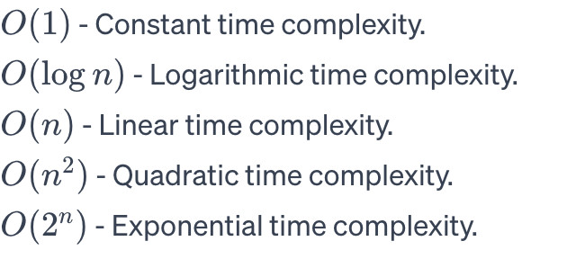
Examples

Slide 10
Big Omega and Theta
Big Omega (Ω) notation represents the lower bound or best-case behavior of an algorithm.
Theta (Θ) notation represents both the upper and lower bounds, indicating a tight bound on the algorithm's complexity.
Big Omega (Ω) is used to describe the best-case scenario.
Theta (Θ) is used when the best and worst-case complexities are the same.

Slide 11
Formally
big-Omega
f(n) is Ω(g(n)) if there is a constant c > 0
and an integer constant n₀ ≥ 1 such that
f(n) ≥ c•g(n) for n ≥ n₀
big-Theta
f(n) is Θ(g(n)) if there are constants c’ > 0 and c’’ > 0 and an integer constant n₀ ≥ 1 such that c’•g(n) ≤ f(n) ≤ c’’•g(n) for n ≥ n₀

Slide 12
Big-Oh
f(n) is O(g(n)) if f(n) is asymptotically less than or equal to g(n)
big-Omega
f(n) is Ω(g(n)) if f(n) is asymptotically greater than or equal to g(n)
big-Theta
f(n) is Θ(g(n)) if f(n) is asymptotically equal to g(n)

Slide 13
Best, Worst, and Average-Case Analysis
Best-Case Analysis: Describes the lower bound or the minimum amount of resource an algorithm requires.
Worst-Case Analysis: Describes the upper bound or the maximum amount of resource an algorithm requires.
Average-Case Analysis: Describes the expected performance of an algorithm on average.

Slide 14
Space complexity
Space complexity is a measure of the amount of memory or space required by an algorithm to solve a computational problem.
It is expressed in terms of the growth rate of space usage concerning the input size.

Slide 15
Auxiliary Space vs. Space Complexity
Space Complexity: The total space used by an algorithm, including both auxiliary space and input space.
Auxiliary Space: The extra space used by an algorithm, excluding the space needed for the input.

Slide 16
Space vs. Time complexity
Like time complexity, space complexity has concepts of Big O, Big Omega, and Theta notations.
The choice between different algorithms may involve considering their space complexity, especially in memory-constrained environments.
Trade-offs
There is often a trade-off between time and space complexity.
More memory-efficient algorithms might have higher time complexity, and vice versa.
The goal is to strike a balance based on the specific requirements of the problem and the constraints of the system.

Slide 17
Optimize space usage
Techniques such as data compression, dynamic programming, and efficient data structures can be employed to optimize space usage.
Designing algorithms with lower space complexity is particularly important in scenarios with limited memory resources.
Space complexity is a critical consideration in modern computing environments, especially in mobile devices, embedded systems, and cloud computing.
Efficient space utilization contributes to better overall system performance and responsiveness.

Slide 18
Computing Time Complexity

Slide 19
How to compute the complexity?
Understand the Algorithm
Carefully read and understand the steps of the algorithm.
Identify the key operations that contribute to the overall running time or space usage.
Identify Input Size
Define the input size, typically denoted as n.
n might represent the number of elements in an array, the length of a string, or some other relevant measure.
Count Basic Operations
Analyze the algorithm to determine the number of basic operations executed in terms of n.
Basic operations are often comparisons, assignments, and arithmetic operations.

Slide 20
How to compute the complexity? Cont’d
Express as a Function of n
Express the count of basic operations as a function of n.
Identify the dominant term that contributes most significantly to the growth.
Drop Lower-Order Terms
Drop lower-order terms and constants, focusing on the dominant term.
For large n, lower-order terms become insignificant.
Apply Big O Notation
Express the dominant term using Big O notation.
Example: If the dominant term is 3n² + 2n + 1, it simplifies to O(n²).
Analyze Nested Loops and Recursion
For nested loops, multiply the complexities.
Analyze recursive algorithms by solving recurrence relations.

Slide 21

Maximum Subsequence Sum Problem
Given (possibly negative) integers A1, A2, . . . , AN, find the maximum value of
Example:
For input −2, 11, −4, 13, −5, −2, the answer is 20 (A2 through A4).

Slide 22
Let's digest this
What is complexity?

Slide 23
Possible scenarios
If all numbers are positive?
If there are negative numbers?
If all of them are negative numbers?
How does the computation time change for each of the above cases?

Slide 24
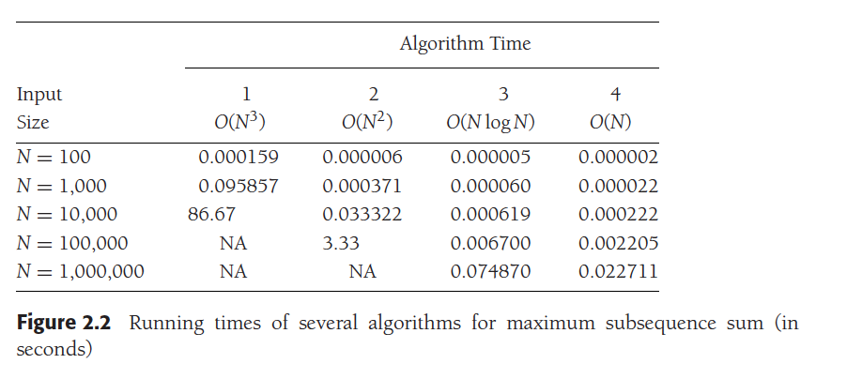
Why is this important?

Slide 25
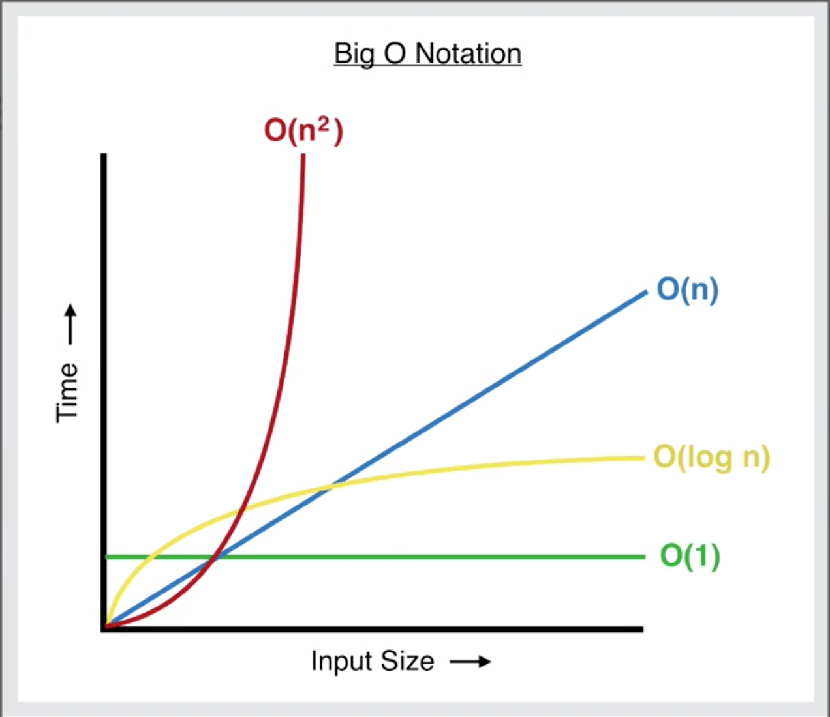
More precisely

Slide 26
Running-Time Calculations
There are several ways
Code, run and compare
Or estimate

Slide 27
A simple program to illustrate
int sum( int n )
{
int partialSum;
1 partialSum = 0;
2 for( int i = 1; i <= n; ++i )
3 partialSum += i * i * i;
4 return partialSum;
}

Slide 28
How do we calculate the run time cost?
The analysis of this fragment is simple.
The declarations count for no time.
Lines 1 and 4 count for one unit each.
Line 3 counts for four units per time executed (two multiplications,
one addition, and one assignment) and is executed N times, for a total of 4N units.
Line 2 has the hidden costs of initializing i, testing i ≤ N, and incrementing i. The total cost of all these is 1 to initialize, N+1 for all the tests, and N for all the increments, which is 2N + 2.
We ignore the costs of calling the function and returning, for a total of 6N + 4.
Thus, we say that this function is O(N).

Slide 29
But we do not need a precise answer, we estimate
For instance, line 3 is obviously an O(1) statement (per execution), so it is silly to count precisely whether it is two, three, or four units; it does not matter.
Line 1 is obviously insignificant compared with the for loop, so it is silly to waste time here.
This leads to several general rules.

Slide 30

General rules for computing run time
Rule 1—FOR loops
Number of iterations
Rule 2—Nested loops
MxN (Normally N²)

Slide 31
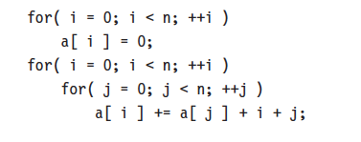
Rule 3—Consecutive Statements
Just add the instructions
This ended up with the max

Slide 32
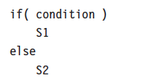
Rule 4—If/Else
the running time of an if/else statement is never more than the running time of the test plus the larger of the running times of S1 and S2.

Slide 33
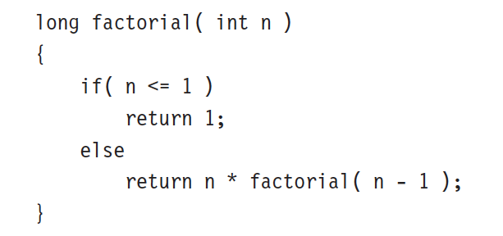
Function calls – recursive functions
This is a simple for loop

Slide 34
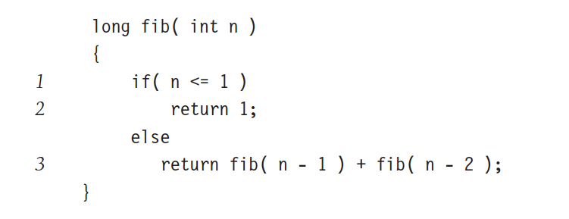
Bad recursive function
This recursion is bad. Why?

Slide 35
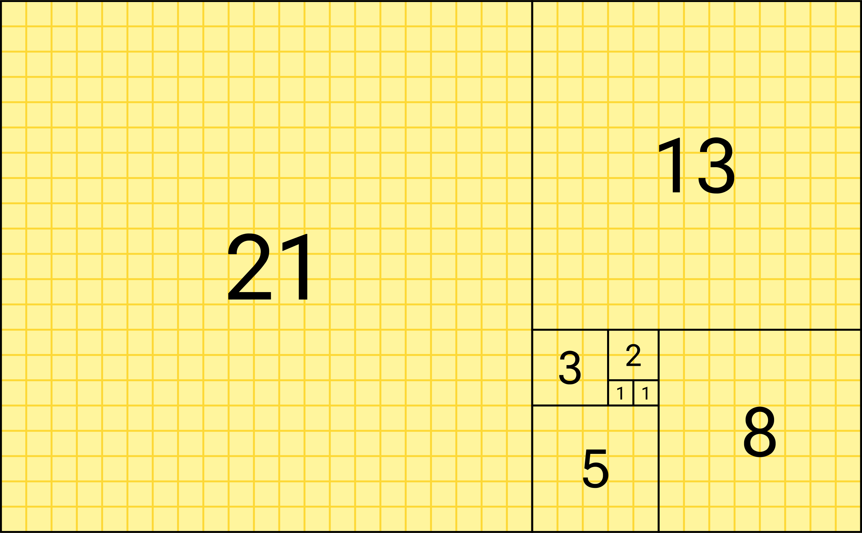
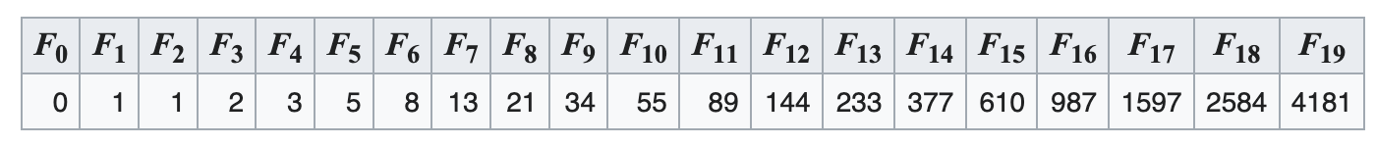
Analysis is simple
T(N) is the time complexity of Fib(N) then
T(N) = T(N − 1) + T(N − 2) + 2

Slide 36
Terrible time complexity
Fib(10) = 89
Time taken for n=10: 0.00s
Fib(50) = 20365011074
Time taken for n=20: 70.39s
Fibonacci series has exponential time complexity

Slide 37

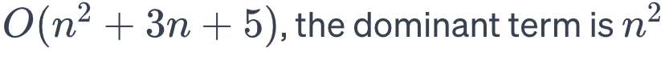



Big O notation rules
Constant Multiplicative Factors are Omitted
Dominant Terms Matter
Addition of Terms
Multiplicative Factors
Drop Lower-Order Terms

Slide 38
Let’s take Maximum Subsequence Sum Problem
Given (possibly negative) integers A1, A2, . . . , AN, find the maximum value of
Example:
For input −2, 11, −4, 13, −5, −2, the answer is 20 (A2 through A4).

Slide 39
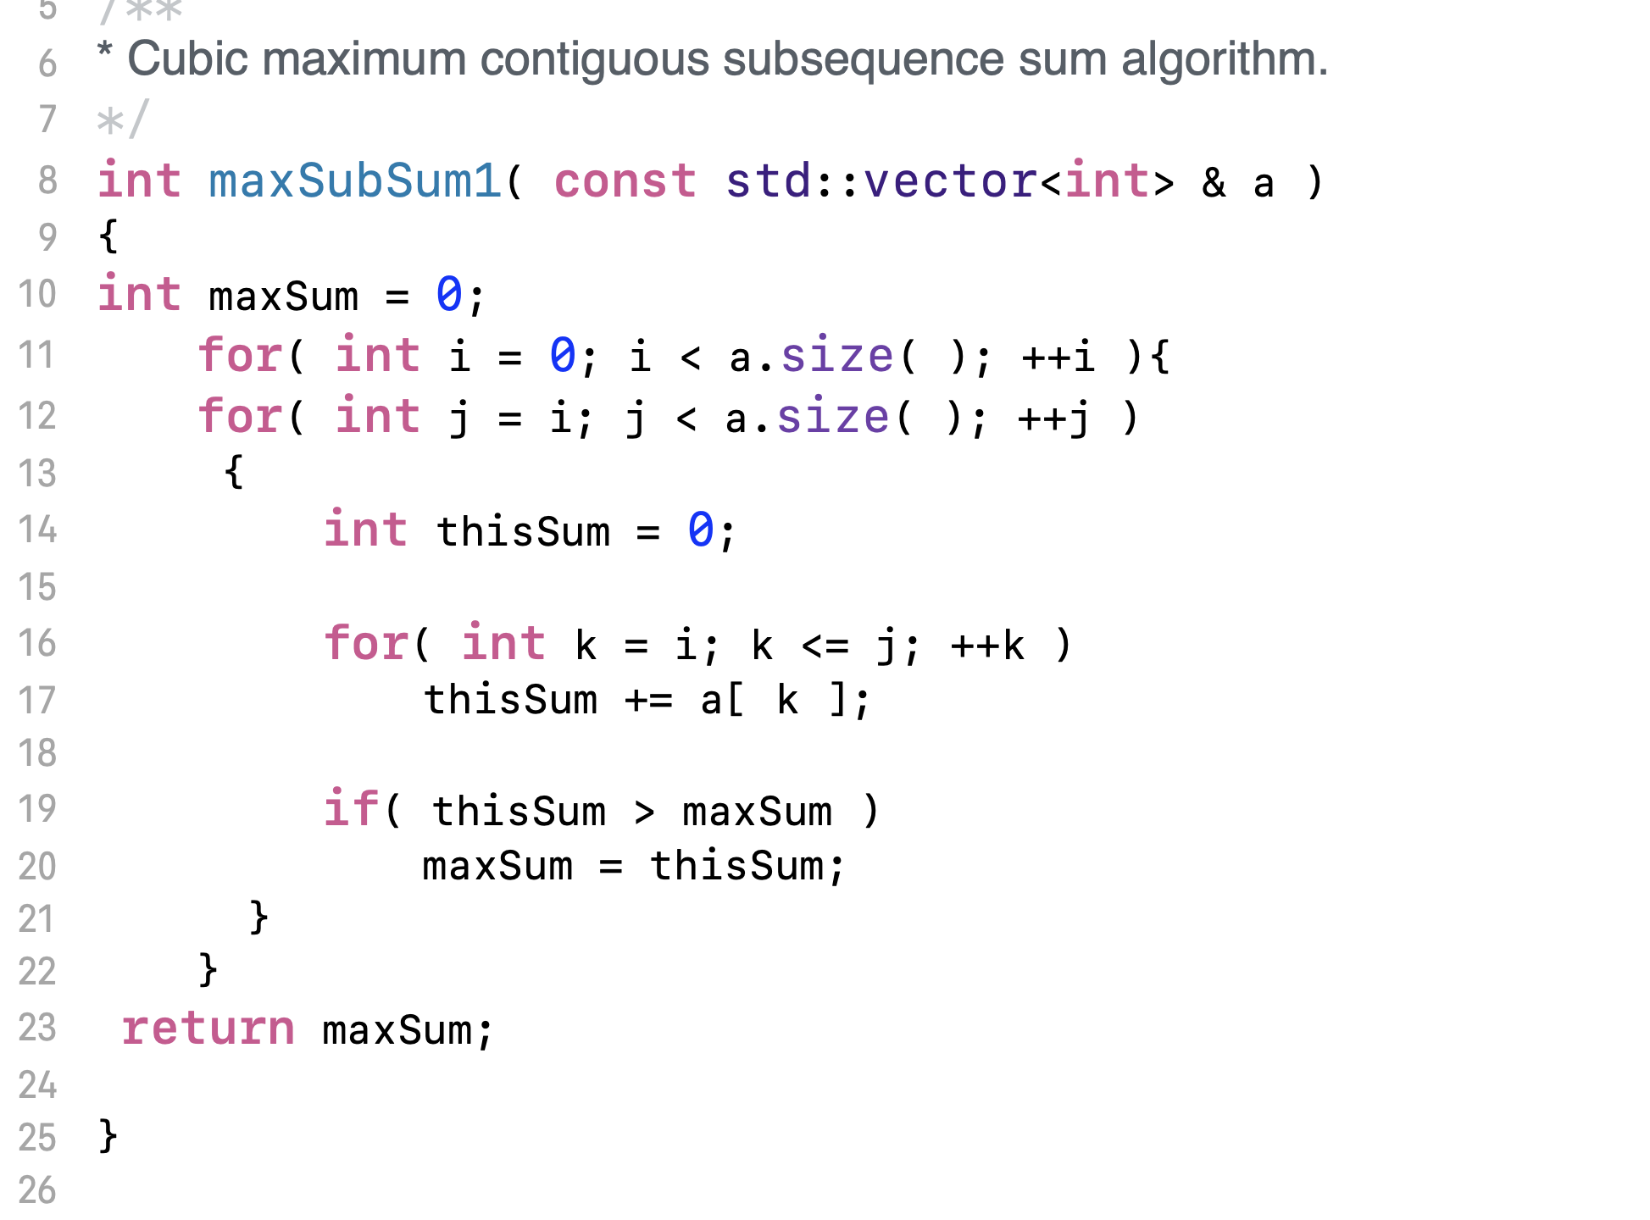
O(N³) Version

Slide 40
Run time
Time taken for 1000 items: 0 seconds
Time taken for 3000 items: 9 seconds

Slide 41

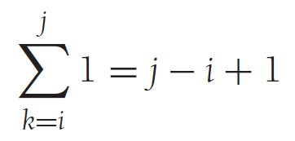
Let’s analyze the algorithm
This has three loops
Let’s work inside out

Slide 42
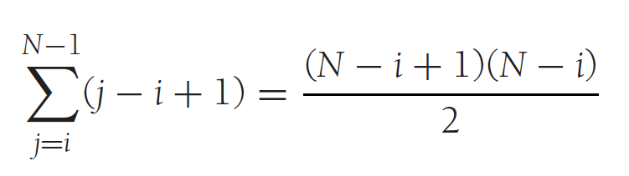
Next outer loop

Slide 43
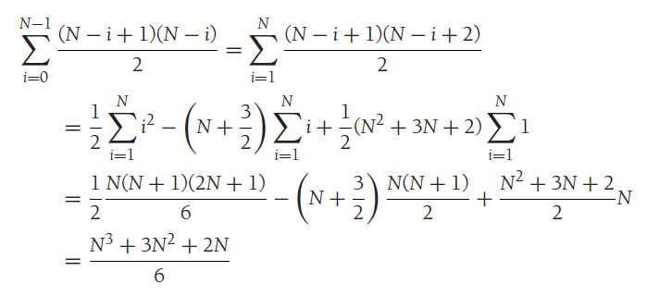
Finally, the outer most loop

Slide 44
By Now
You should understand the importance of the algorithm analysis

Slide 45
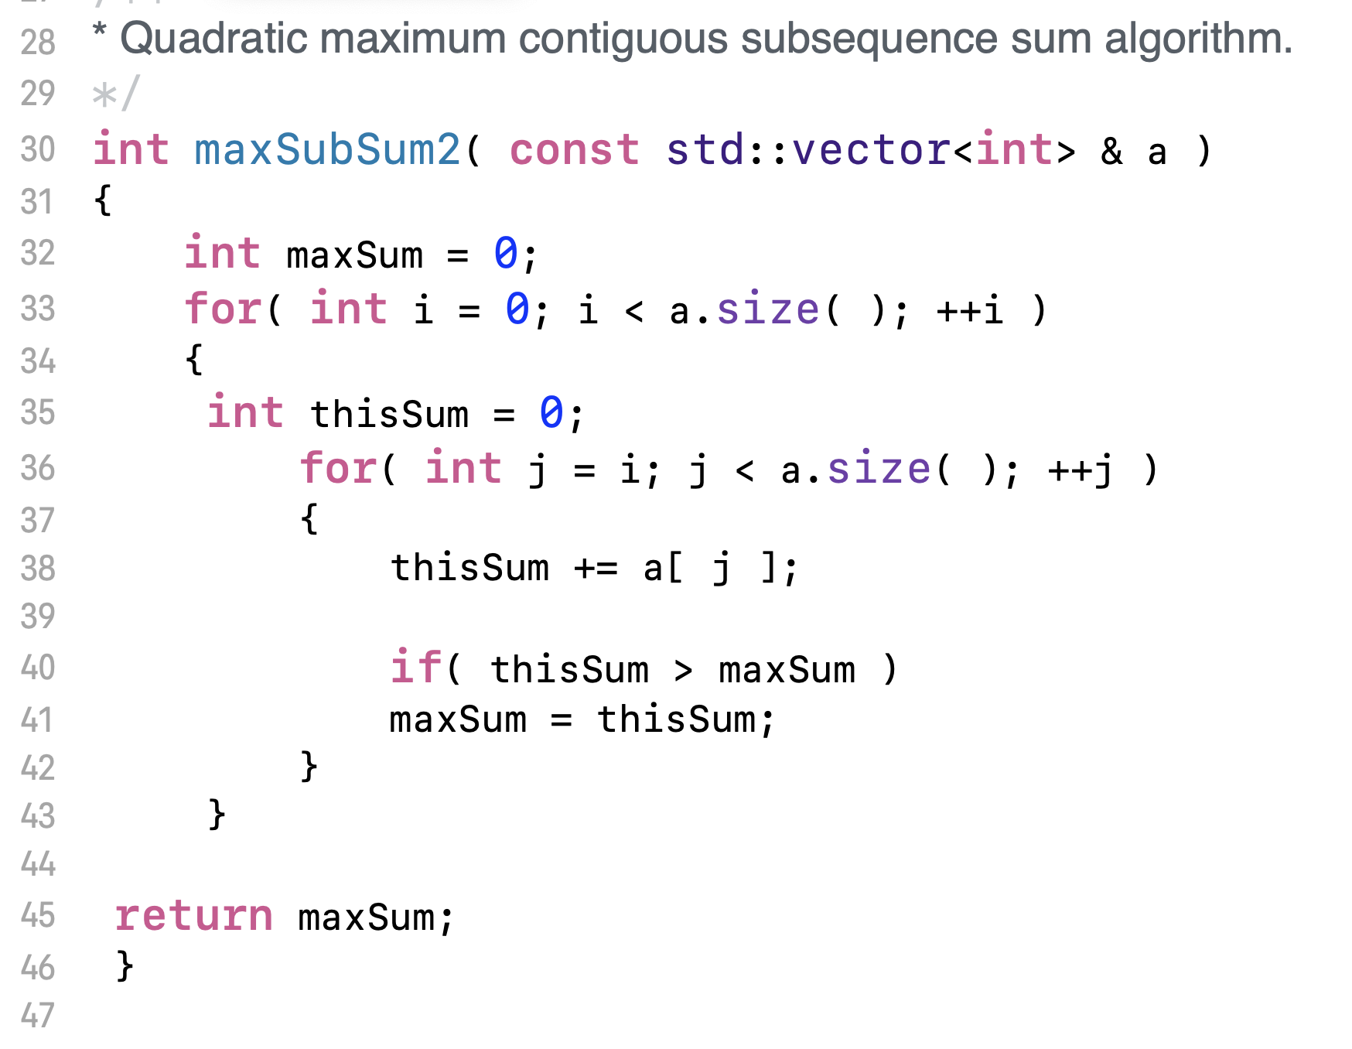
We can improve the Max Sum algorithm
We can remove a loop

Slide 46




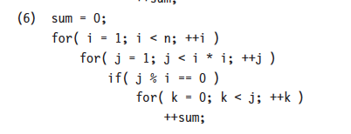
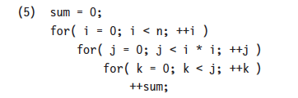
Exercise – Estimate the Big O

Slide 47
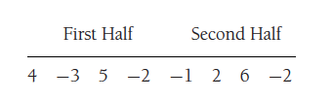
N log N version of Sum of sub array
Divide and conquer

